Slide 1
PORTFOLIO PERFORMACE APPRAISAL
quarterly review meeting – q3 2017 vs q4 2017

Slide 2
Executive summary
Alpha is doing cautiously well
Alpha’s portfolio has been growing in size along with performance improvement across all the sectors
The Roads sector has been an out-performer amongst all the other sectors in Alpha
However, there are some risky investments in the portfolio which require close monitoring

Slide 3
Alpha is a long term, actively managed and risk-averse investment company
Investment Philosophy
Dynamic Portfolio Management
Proactive Participation
Sectoral Allocation
Broad based sectoral allocation
Sovereign debt to reduce risk
Investment Type
Fixed income and debt securities only
No equity exposure
3-5 years investment horizon
Conservative Investment Approach
No pre-determined allocation in sectors
Fund manager discretion allowed
Investments in high quality companies
Investments in publicly traded securities

Slide 4
Alpha is a growing investment fund across all sectors
Alpha’s portfolio comprised 4 major sectoral allocation namely Schools, Roads, Sovereign debt and Commercial Real Estate
Roads are the biggest sector in the overall portfolio with USD 135mn in investment in Q4 2017
Commercial Real Estate is the second biggest sector with USD 125mn in investment in Q4 2017
Schools and Sovereign debt are relatively smaller in size with USD 105mn and USD 100mn in investment in Q4 2017
465
395

Slide 5
All sectors have shown a performance improvement in Q4 vs Q3 2017
The interest yields generally increased across all sectors between Q3 2017 and Q4 2017
Roads continue to be the highest interest earning asset at 6.5% p.a. in Q4 2017
Schools are the second highest earning asset class in the portfolio at 4.4% in Q4 2017
Commercial Real Estate earn a decent 3.4% p.a. as investment yield in Q4 2017
Sovereign debt being the safest investment earns the lowest interest yield 2.5% p.a. in Q4 2017

Slide 6
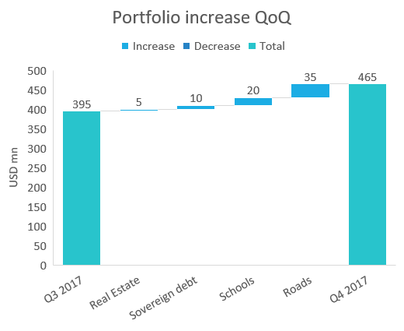
Alpha is most bullish on the Roads sector
The portfolio has increased 70mn USD between Q3 2017 and Q4 2017
The investments in the Road sector has been the highest amongst all sectors in Q4 2017
The Schools sector has also seen a modest increase in investment of 20mn USD in Q4 2017
Investment in Sovereign debt has also increased by 10mn USD in Q4 2017
Real Estate has seen the lowest increase in investment in Q4 2017 at 5mn USD only

Slide 7
The Roads sector is a lucrative investment from a risk-return trade-off
Overall, the portfolio exhibits a trade-off between risk and return profile at the individual asset class loans
Road's sector has the highest return while the risk is relatively lower compared to Schools and CRE
Sovereign debt is the lowest return generating asset class with the lowest risk profile as well in the overall portfolio
CRE and Schools have moderate returns but higher risk profile in the overall portfolio

Slide 8
The market is bullish on the potential of the Roads sector
In general, the portfolio price is below the book value of investments except for Sovereign debt in Q4 2017
There has been a general increase in the price of all sectors in the portfolio from Q3 2017 to Q4 2017
The Roads sector has shown the maximum improvement in the price of 10% in Q4 2017 vs Q3 2017
Sovereign debt has increased 7% point between the last 2 quarters
Commercial real estate and Schools have shown a very small increase in price in Q4 2017

Slide 9
However, there are high risk investments that Alpha should monitor closely
There has been considerable change in the risk quality of the portfolio in Q4 2017 vs Q3 2017
The low risk investments have increased from 35% in Q3 2017 to 46% in Q4 2017
The medium risk investments have increased from 23% in Q3 2017 to 30% in Q4 2017
The high risk investments have decreased from 42% in Q3 2017 to 24% in Q4 2017

Slide 10
OS Buildings and Saffron Buildings require close monitoring from credit Risk
High Risk Loan Investments | Asset class | % of portfolio | Book value of investment (USD mn) | Yield (%)
OS Buildings | Commercial Real Estate | 5% | 21 | 7
Saffron Buildings | Commercial Real Estate | 5% | 21 | 5
CLM Roads - II | Roads | 4% | 20 | 4
Xie John Road Association - AA | Roads | 4% | 19 | 7
MV Roads - Phase 2 | Roads | 3% | 15 | 3
DS Schools Association - I | Schools | 1% | 6 | 6
CVNT Buildings - Part B | Commercial Real Estate | 1% | 5 | 4
CVNT Buildings - Part A | Commercial Real Estate | 1% | 4 | 6
Total |  | 24% | 111

